Slide 1

Computational Simulation to Characterize the Formation of Tumor Organoids
Ulises Nino Espino
Devi Laboratory
Lab Meeting, April 3rd, 2020

Slide 2
Research Goal
Simulate the formation and cell dynamics of a tumor emboli

Slide 3

Background
Various 3D models have improved the study of host-tumor interactions
Time and resources required to create multicellular 3D spheroids and organoids in vitro
Limit high-throughput assessment of factors contributing to or targeting their formation
Ramesh et al. 2011

Slide 4
Experimental Aims
Aim 1: To simulate a tumor organoid model that contains various relevant biological aspects of a tumor cell
Aim 2: Integrate factors into this system where more than one cell proliferates in the local environment and includes a lymphatic shear stress parameter

Slide 5
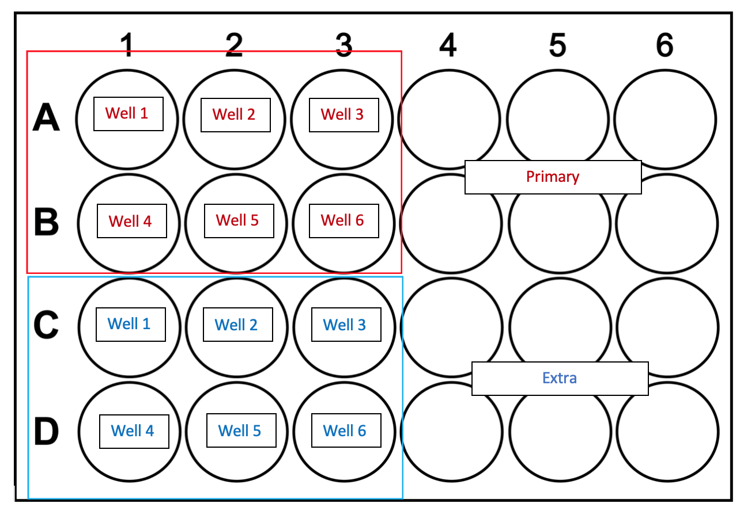
Methods – In Lab
Seeded with P95 wtXIAP SUM149 cells (IBC) at a density of 10,000 images per well
Images were taken of each well every 24 hours for 7 days after seeding
ImageJ Analysis to obtain Tumor Emboli Area
Circularity: 0.25 – 1.00
5(2)

Slide 6
Methods – Computational Tumor Set Up
Three Cell Types
Epithelial (motile, proliferative: 0.000925 /min)
Mesenchymal (motile)
Cancer Steam Cells (CSC) (motile, proliferative)
Cell Model
Live
Flow cytometry separated cycle model
Environment
Initial oxygen concentration at 38 mmHg
Oxygen-dependent cell proliferation and death rates
Simulation Rate 1/min unit: 18 hr = 0.000925 /min

Slide 7
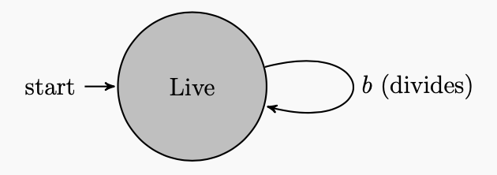
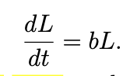
Methods – Epithelial Cell Model
Live Models
Rates between Phases (1/min units)
Transition rate from the Live state to the Live state is
transition rate(0, 0) = b
= 18 hr
= 0.000925

Slide 8
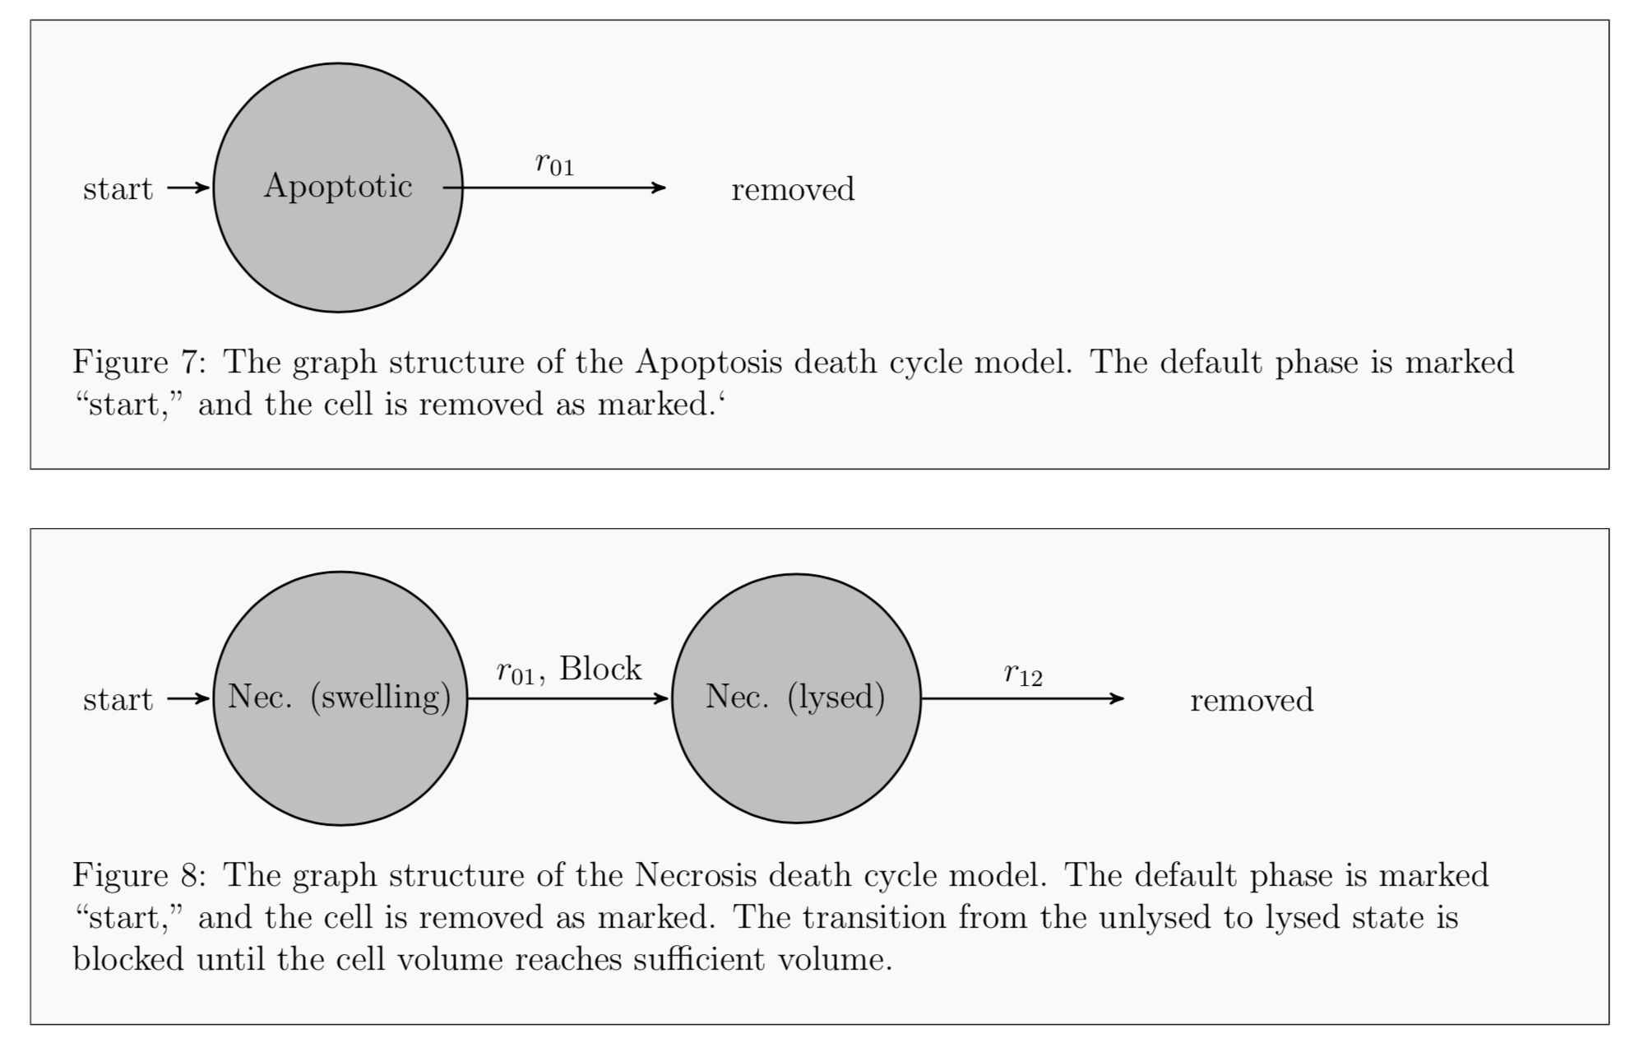
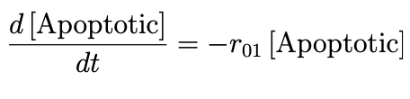
Methods – Epithelial Death Model
Death Models
Rates between Phases (1/min units)
The graph structure of the Apoptosis death cycle model. The default phase is marked “start,” and the cell is removed as marked.‘
Initialized apoptotic death rate to 0 – no epithelial cells are dying

Slide 9
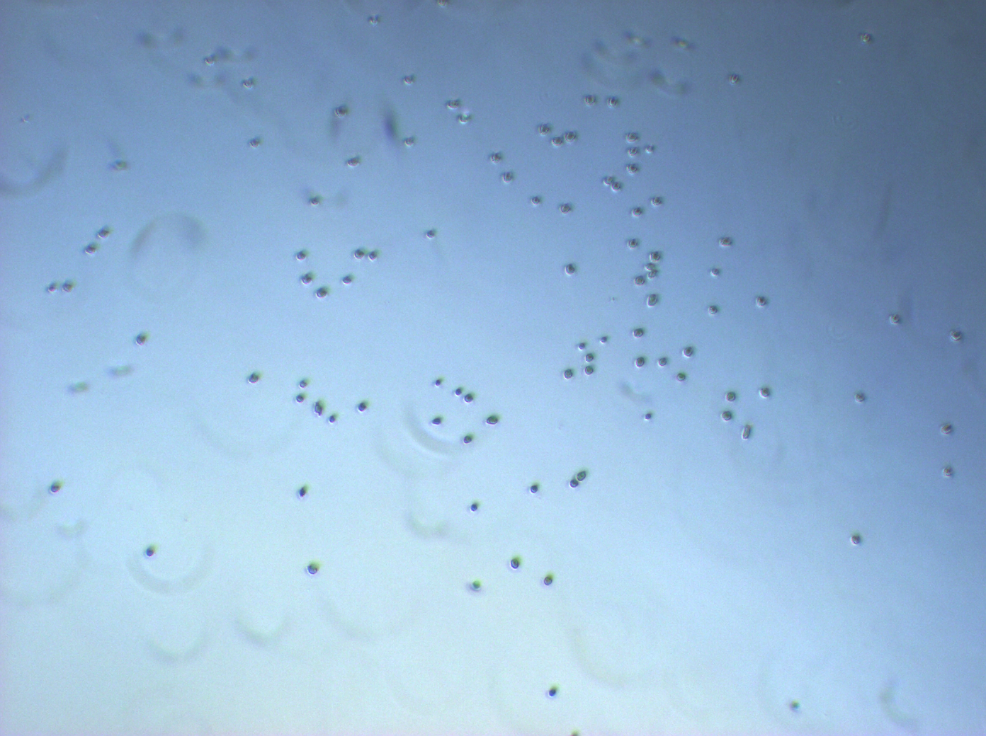
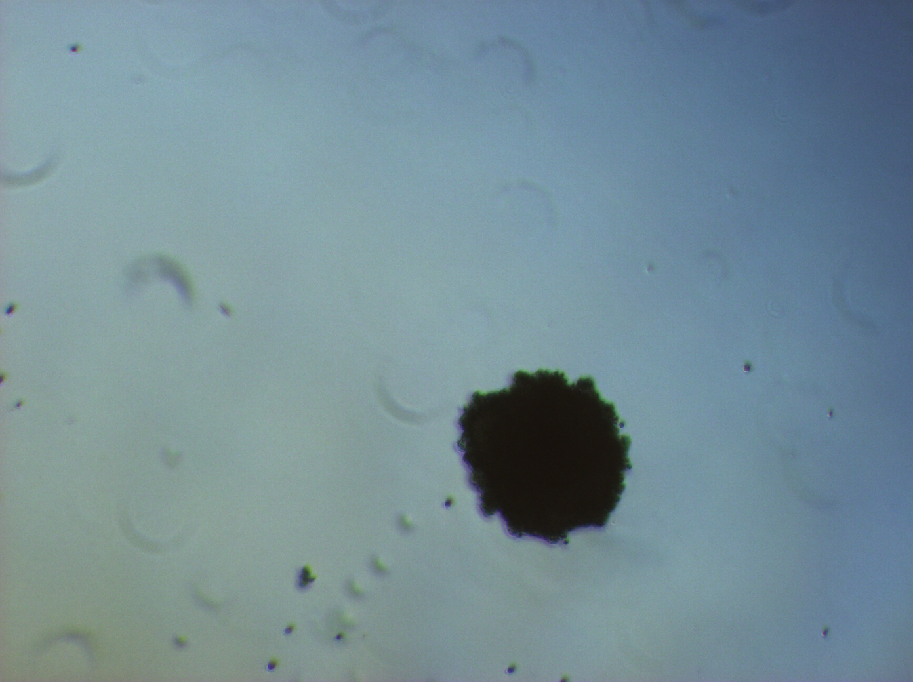
Stage
Sporadic Cells
Tumor Emboli
Epithelial cell spread out
Bias direction for other epithelial cells
Apply shear stress force
Neurotic cycle once cells are in the core of the tumor/oxygen deprived
Continuation of shear stress force

Slide 10
Methods – Epithelial Motility Bias
double migration_bias: degree of cell’s motility bias.
0 = completely Brownian, 1 = completely bias direction
Currently set to 0.5
double migration_speed: speed of motility
units of μm/min
Currently set to 0.2
double persistence_time: the mean time cell continues at its current speed and direction before
Currently set to 1
epithelial_taxis: function that update the motility bias vector towards other epithelial cells

Slide 11
Additional Parameters
cell-cell adhesion and repulsion relative to other cells
double cell cell adhesion strength: relative strength of cell-cell adhesive forces
Currently set to 0.05
double cell cell repulsion strength: relative strength of cell-cell repulsive forces
Currently set to 0.8
Cells Radius:
Currently set to 7.065 μm

Slide 12
Epithelial Taxis Function – Code
void epithelial_taxis( Cell* pCell , Phenotype& phenotype , double dt )
{
static int epithelial_i = microenvironment.find_density_index( "epithelial" );
phenotype.motility.migration_bias_direction = pCell->nearest_gradient(epithelial_i);
normalize( &(phenotype.motility.migration_bias_direction) );
return;
}

Slide 13
Setting Up Cells In Environment - Code
Seeding – 250 Cells
int number_of_epithelial = parameters.ints( "epithelial_initial_count" );
for( int n = 0; n < number_of_epithelial ; n++ )
{
std::vector<double> position = {0,0,0};
double x = X_left + 0.1*X_length + 0.8*X_length*UniformRandom();
double y = Y_left + 0.1*Y_length + 0.8*Y_length*UniformRandom();
position[0] = x;
position[1] = y;
pC = create_cell( epithelial );
pC->assign_position( position );
}

Slide 14
Results

Slide 15
In Vitro Tumor Emboli

Slide 16
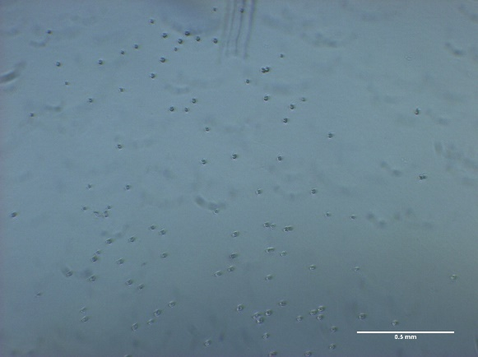
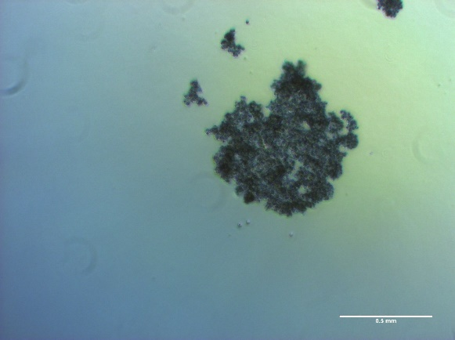
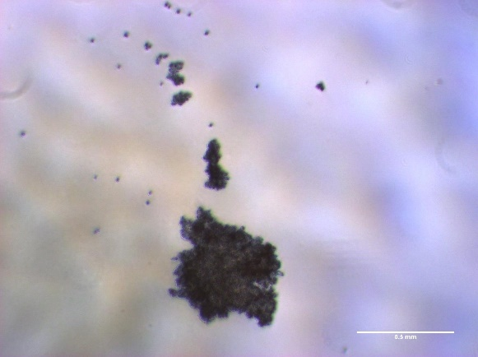
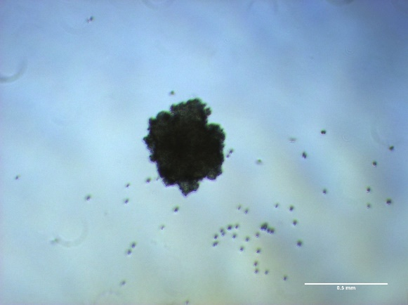
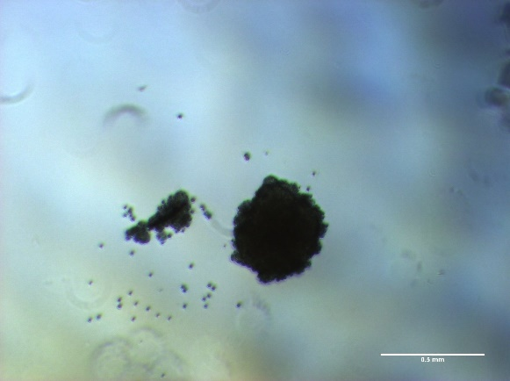
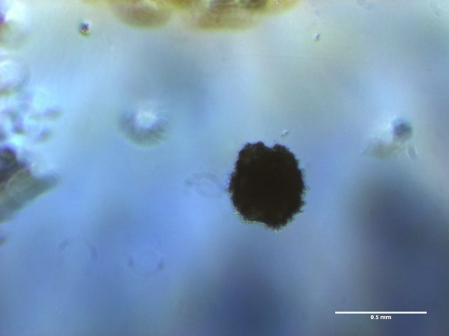


In Vitro Tumor Emboli Growth – Well 1
0 hr
24 hr
48 hr
72 hr
96 hr
120 hr
144 hr
168 hr
Images taken at 4x magnification - light microscope

Slide 17
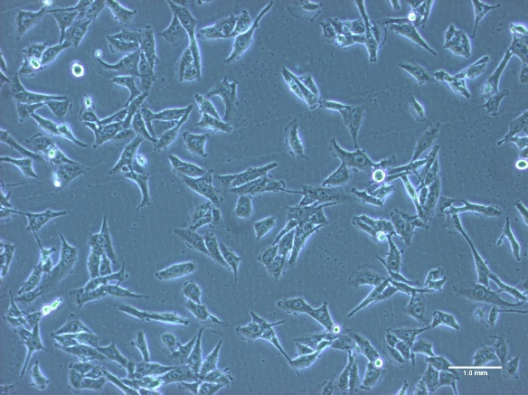
In Vitro Tumor Emboli Growth – Well 1
0 hr
24 hr
48 hr
72 hr
96 hr
5 d
6 d
7 d
Images taken at 4x magnification - light microscope

Slide 18
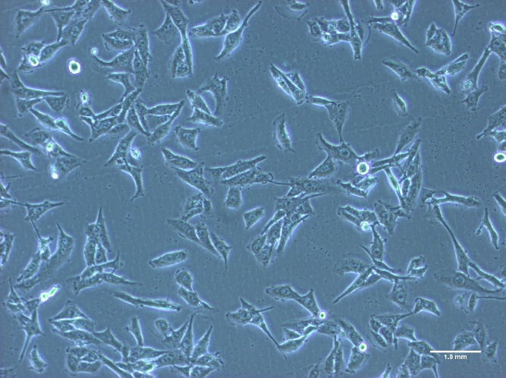
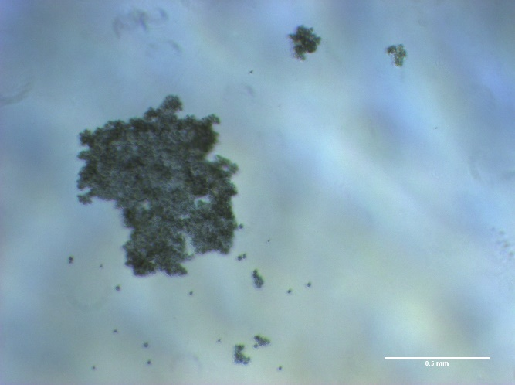
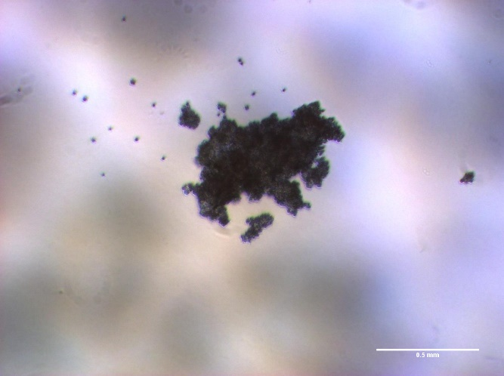
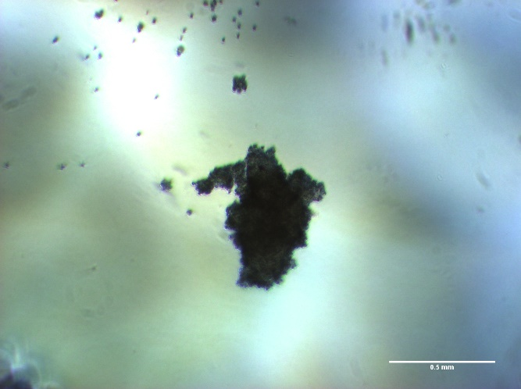
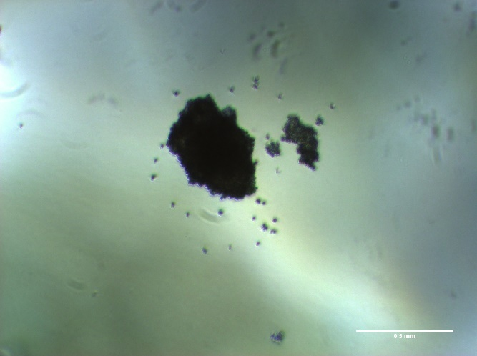
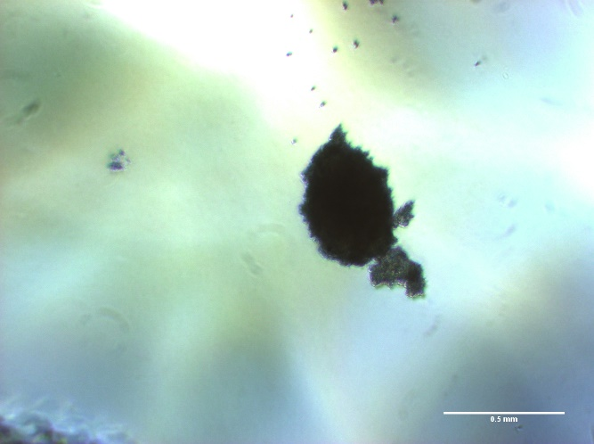
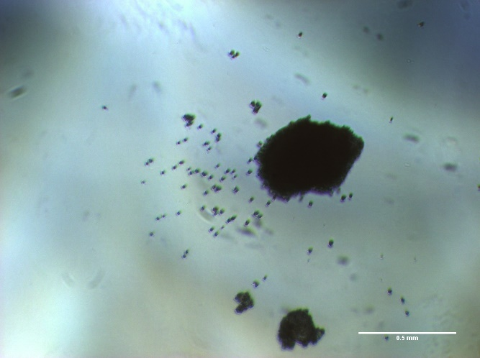
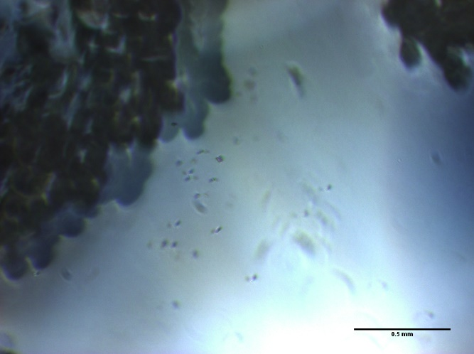
In Vitro Tumor Emboli Growth – Well 2
0 hr
24 hr
48 hr
72 hr
96 hr
5 d
6 d
7 d
Images taken at 4x magnification - light microscope

Slide 19
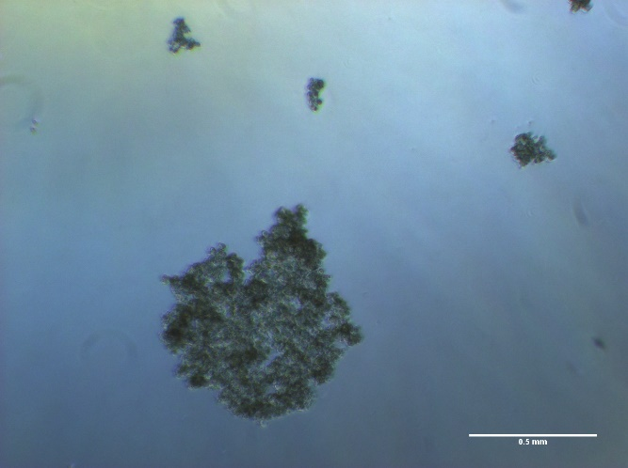
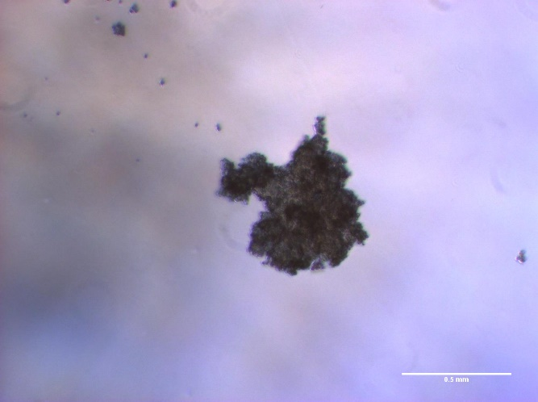
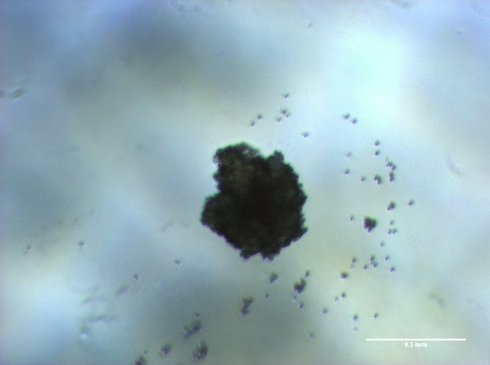
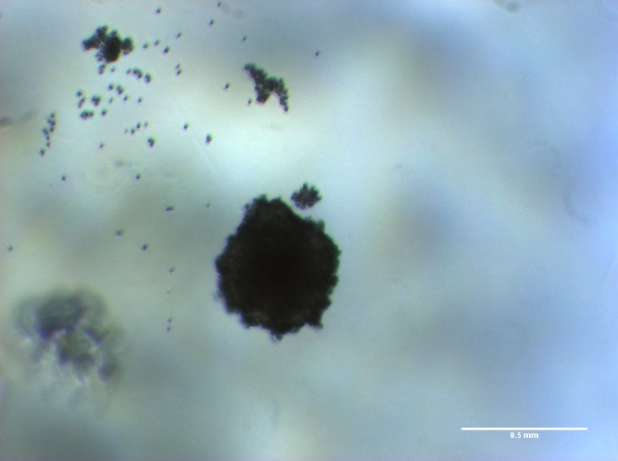
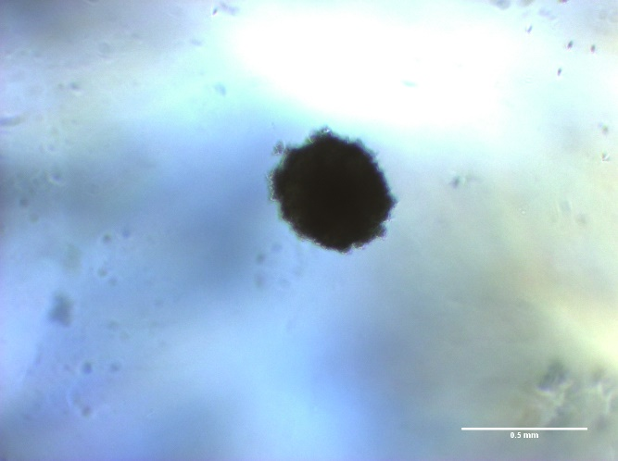
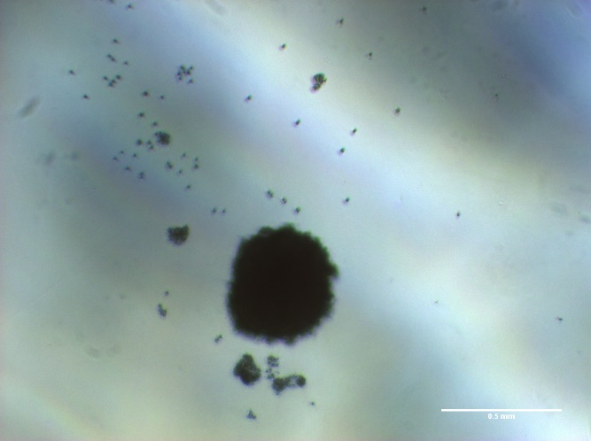
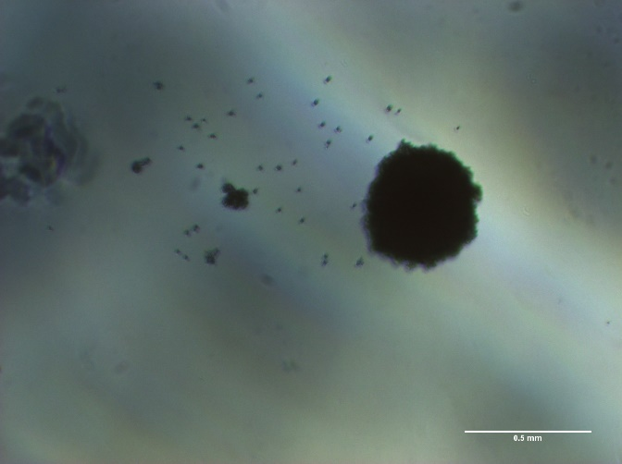
In Vitro Tumor Emboli Growth – Well 3
0 hr
24 hr
48 hr
72 hr
96 hr
5 d
6 d
7 d
Images taken at 4x magnification - light microscope

Slide 20
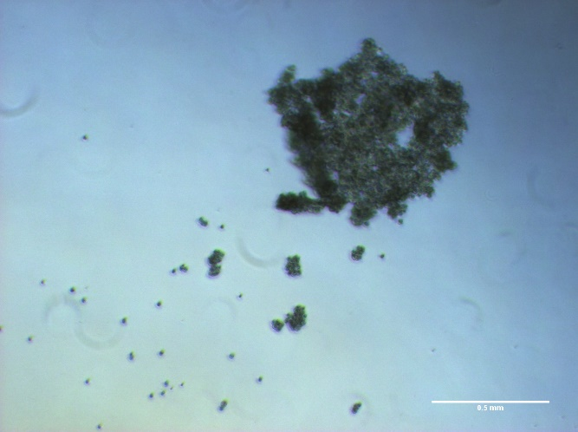
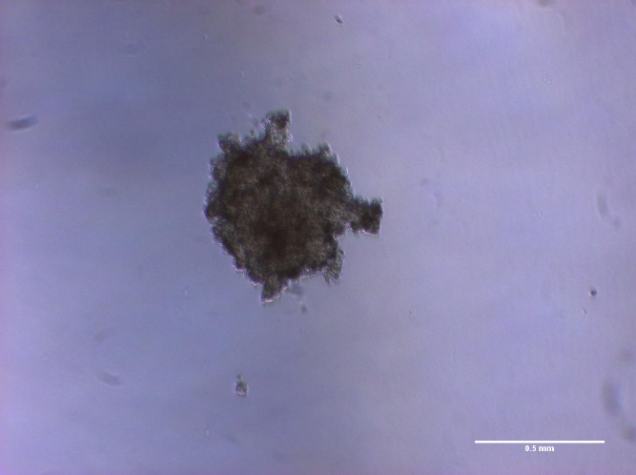
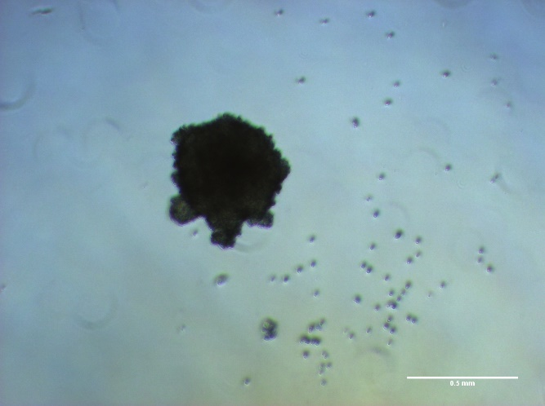
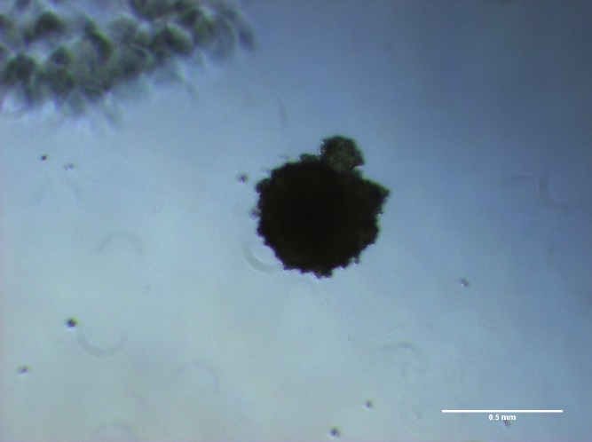
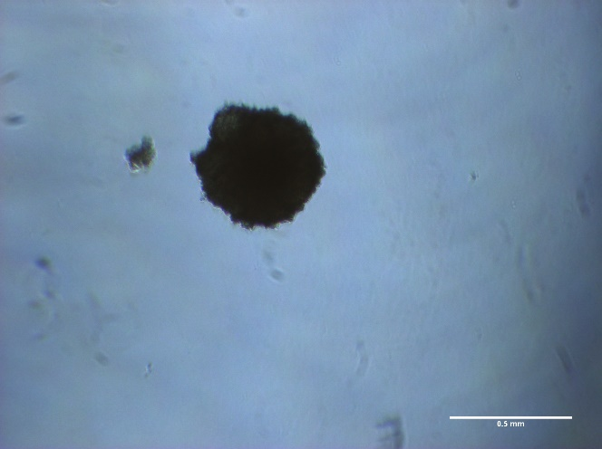
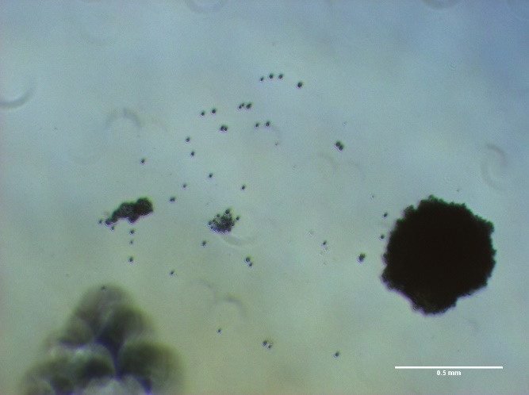
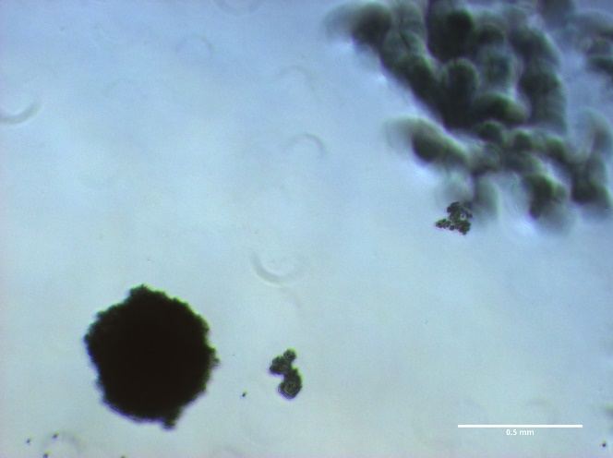
In Vitro Tumor Emboli Growth – Well 4
0 hr
24 hr
48 hr
72 hr
96 hr
5 d
6 d
7 d
Images taken at 4x magnification - light microscope

Slide 21

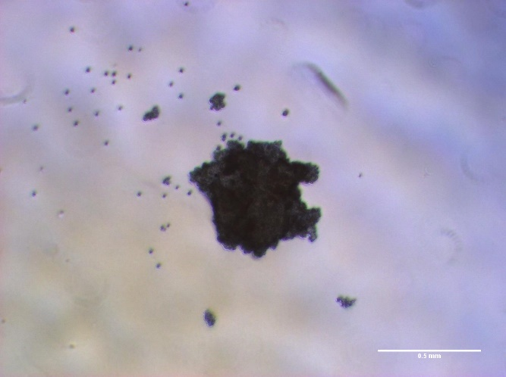
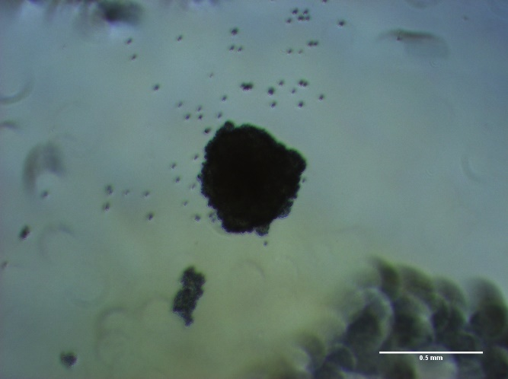
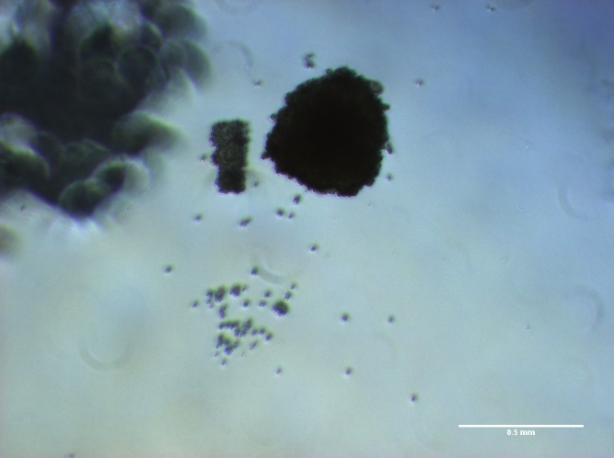
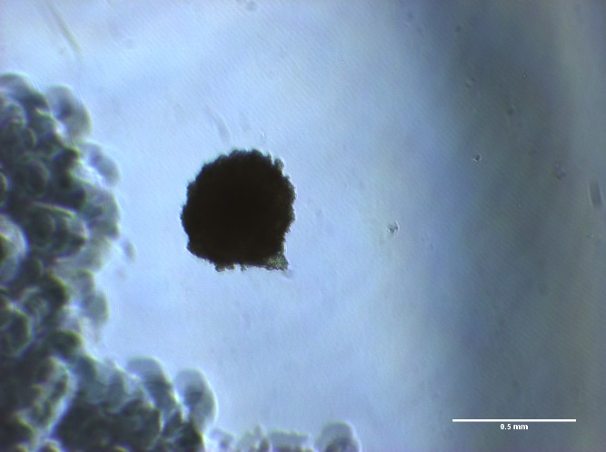
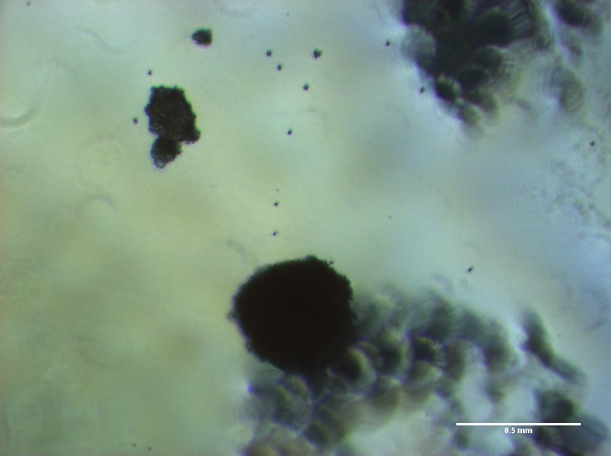
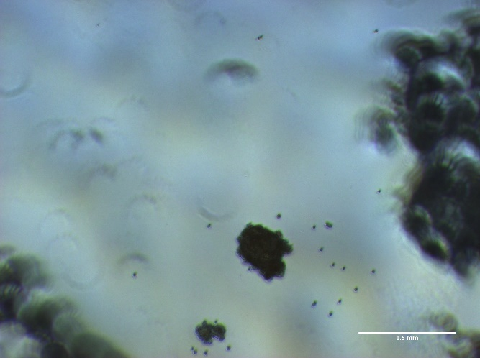
In Vitro Tumor Emboli Growth – Well 5
0 hr
24 hr
48 hr
72 hr
96 hr
5 d
6 d
7 d
Images taken at 4x magnification - light microscope

Slide 22
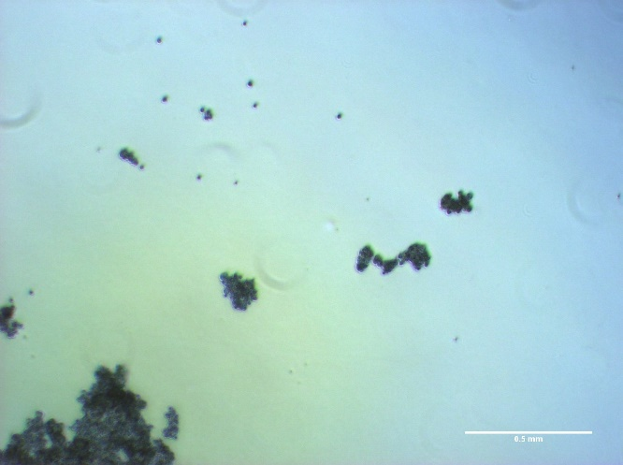
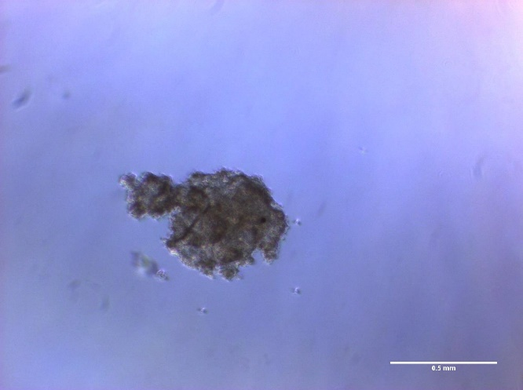
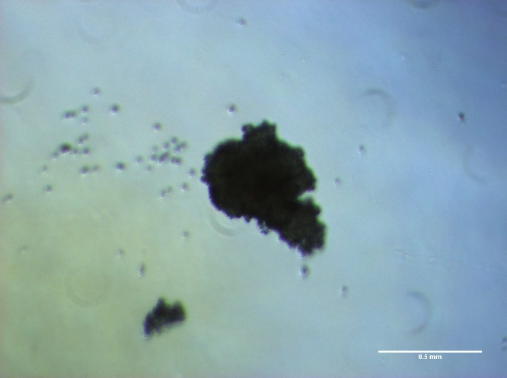
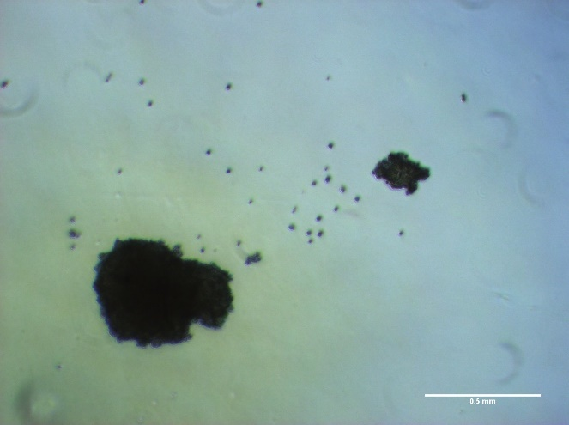
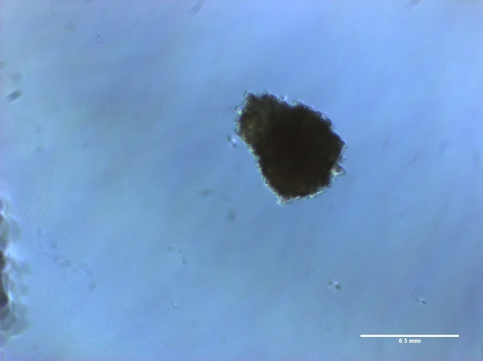
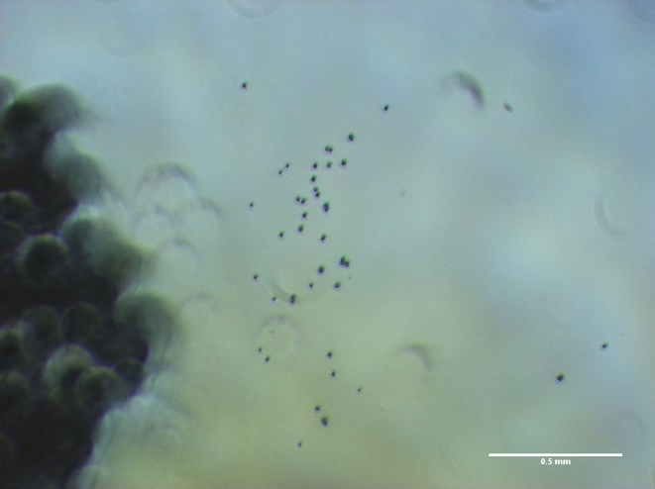
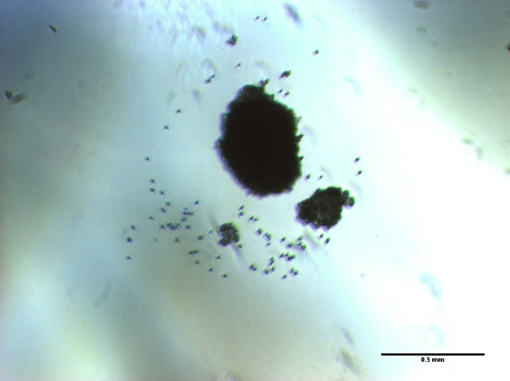
In Vitro Tumor Emboli Growth – Well 6
0 hr
24 hr
48 hr
72 hr
96 hr
5 d
6 d
7 d
Images taken at 4x magnification - light microscope

Slide 23
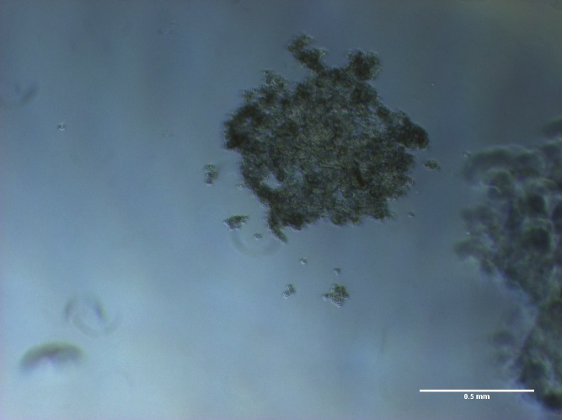





In Vitro Tumor Emboli Growth – Well 7
0 hr
24 hr
48 hr
72 hr
96 hr
5 d
6 d
7 d
Images taken at 4x magnification - light microscope

Slide 24






In Vitro Tumor Emboli Growth – Well 8
0 hr
24 hr
48 hr
72 hr
96 hr
5 d
6 d
7 d
Images taken at 4x magnification - light microscope

Slide 25






In Vitro Tumor Emboli Growth – Well 9
0 hr
24 hr
48 hr
72 hr
96 hr
5 d
6 d
7 d
Images taken at 4x magnification - light microscope

Slide 26







In Vitro Tumor Emboli Growth – Well 11
0 hr
24 hr
48 hr
72 hr
96 hr
5 d
6 d
7 d
Images taken at 4x magnification - light microscope

Slide 27






In Vitro Tumor Emboli Growth – Well 12
0 hr
24 hr
48 hr
72 hr
96 hr
5 d
6 d
7 d
Images taken at 4x magnification - light microscope

Slide 28

In Vitro Tumor Emboli Growth – Additional Images
0 hr
24 hr
48 hr
72 hr
96 hr
120 hr
144 hr
168 hr
Images taken at 4x magnification - light microscope

Slide 29
ImageJ Analysis For Each Well
 | 0hr | 24hr | 48hr | 72hr | 96hr | 120hr | 144hr | 168hr
1(1) | 621 | 33021, 4 | 75746 | 82387, 2 | 73724, 2 | 62607 | 50471 | 62816, 3
2(1) | 142.7, 10 | None | 84236 | 88967, 2 | 76025, 2 | 61878 | 60228, 3 | 63923, 3
3(1) | 304, 16 | 47425, 3 | None | 68560 | 75474, 2 | 71270 | 62671, 4 | 58983, 3
4(1) | 263.4375, 16 | 60339,2 | None | 69133 | 69441 | 72073 | 58117, 2 | 57377
5(1) | 167.451613, 31 | None | 82987 | 62692 | 62869 | 55633 | 73148, 2 | 22554, 2
6(1) | 170.090901,33 | 123980 | 60492 | 57447 | 55749 | 54686 | 76084, 3 | 71880, 2
1(2) | 430, 2 | 7637.75, 8 | 21116,4 | 60904 | 62966, 2 | 46367
2(2) | 200.54, 22 | 48864.6667,3 | 29520.6667,3 | 67921, 2 | 60447, 2 | 61863
3(2) | 164.714286, 7 | 24049.5,2 | 79697 | 76365 | 63876, 2 | 55198
4(2) | 283.090909,11 | 2906.42857,7 | 81542 | 67957 | 61600 | 56476
5(2) | 237.4,10 | 1645 | 38688.5,2 | 69810, 2 | 71947, 2 | 57424
6(2) | 237.043478, 46 | 1543.33333,3 | 86238 | 71285 | 67922 | 65511, 2
Red = Primary
Blue = Extra
Size Pixel² = 100 – infinity: 0 hr
= 1000 – infinity: 24hr -

Slide 30
Tumor Emboli Area Growth
Growth Phase
Death Phase

Slide 31
Simulation Tumor Emboli

Slide 32
Simulation Tumor Emboli Growth
0 hr – 250 Cells
24 hr – 309 Cells
48 hr – 400 Cells
72 hr – 531 Cells
96 hr – 664 Cells
120 hr – 871 Cells
144 hr – 1135 Cells
168 hr – 1514 Cells

Slide 33

Simulation of Tumor Emboli 7 Days
Seeded 250 Epithelial Cells
Center (x =0, y = 0):
Oxygen Concentration Initial: 38 mmHg
Oxygen Concentration Final: 34.98 mmHg

Slide 34
Summary Statistics of Simulation
Total volume = 3574208.074150933
position_x position_y total_volume current_phase migration_speed
0 -53.046895 112.571901 2494.000000 14.0 0.2
1 40.591360 159.232617 2492.836350 14.0 0.2
2 30.965474 152.984076 2490.277169 14.0 0.2
3 -8.634057 140.719236 2491.088537 14.0 0.2
... ... ... ... ... ...
1500 -223.854848 44.364250 1255.816909 14.0 0.2
1501 59.641904 40.823400 1255.816436 14.0 0.2
1502 189.631795 13.532924 1246.752812 14.0 0.2
Cell Type Count
0 epithelial 1503

Slide 35
Tumor Emboli Area For Simulation
Simulation Tumor Emboli Area – Using ImageJ
24hr | 48hr | 72hr | 96hr | 120hr | 144hr | 168hr
2655.84296 | 5788.4854 | 17127.2987 | 106085.919 | 129494.12 | 161330.185 | 204820.356
Continuous Growth
Scale: 200 μm
Circularity: 0.00 – 1.00

Slide 36
Comparison Between Simulation and In Vitro
Rate of Growth
Percent Rate of Growth
 | In vitro | Simulation
24 - 48 | 2.530387671 | 0.54118517
48 - 72 | 0.317314504 | 0.66203162
72 - 96 | -0.199217859 | 0.83855257
96 - 120 | 0.313835693 | 0.18076652
120 - 144 | -0.542353778 | 0.19733483
144 - 168 | -0.050106634 | 0.21233325
 | In vitro | Simulation
24 - 48 | 253.04% | 54.12%
48 - 72 | 31.73% | 66.20%
72 - 96 | -19.92% | 83.86%
96 - 120 | 31.38% | 18.08%
120 - 144 | -54.24% | 19.73%
144 - 168 | -5.01% | 21.23%

Slide 37
Cell Features
Epithelial
EBFR Receptor
Binding rate
Threshold inducing EMT
E-cadherin
Mesenchymal
EBFR
E-cadherin
N-Cadherin
CSC
CD44^{high}/CD24^{low} cell surface proteins
Environment
EGF administered to the extracellular space

Slide 38


Future Model For Cells
Flow cytometry separated cycle model
Rates between Phases (1/min units)

Slide 39
Future Death Model
Death Models

Slide 40
Flow Cytometry To Obtain Rates – Future
Flow Cytometry
Current Values:
Markers for Cell Cycle (SUM149 FG12):
Mesenchymal = Purified anti-CD105 (Endoglin) Antibody
Epithelial = APC anti-human CD326 (EpCAM) Antibody
Stem Like = APC anti-human CD135 (Flt-3/Flk-2) Antibody
Future Values:
1

Slide 41

EMT Model

Slide 42
EMT Model
E State
1.2
2.2
3.2
M State
CSC State
1.1 E-non-CSC
1.2 E- CSC
2.1 E/M – non-CSC
2.2 E/M – CSC
3.1 M – non-CSC
3.2 M – CSC
1.1
2.1
3.1
Phase 1
Epithelial Cells with apico basal polarity
E-cadherin expression
Higher Cell-Cell Adhesion
Phase 2
Loss of apico basal polarity
Lower levels of Cell-Cell Adhesion
Phase 3
Mesenchymal Phenotype
Motile
Lower levels of Cell-Cell Adhesion
Low expression of N-Cadherin

Slide 43
EMT Model
1.2
2.2
3.2
CSC Hybrid
1.1
2.1
3.1
Non-CSC Hybrid
EGF
SNAI1
ZEB1
EMT Induced
E/M Hybrid Induced
M Phenotype Induced
EGF: Epidermal growth factor stimulates cell growth, proliferation, and differentiation by binding to EGFR
SNAI1: Transcription factor that promotes the repression of the adhesion molecule E-cadherin to regulate EMT
ZEB1: Transcription factor that downregulates E-cadherin and induces epithelial to mesenchymal transition

Slide 44
EMT Model
CSC Hybrid
Sending Cell
1.2
2.2
3.2
IL-6
NOTCH Receptor
1.1
2.1
3.1
Stem-like characteristics Induced
Receiving Cell
IL-6: Interleukin 6 is a pro-inflammatory cytokine with the maintenance of EMT “stemness”
Non-CSC Hybrid

Slide 45

Shear Stress Force
$Shear Stress= 𝒯=3πμσ_{max}/4δ^{2}T$
Where $δ= d_{0}/L$ ($d_{0}$ = depth of medium and L = length of flask), $μ$ = viscosity of medium, $σ_{max}$ = 0.035, $T$ = time for 1 cycle in seconds.
Function:
void (*update_velocity)( Cell* pCell, Phenotype& phenotype, double dt );
pCell: pointer to cell
Phenotype: phenotype of cell
dt: time

Slide 46
Questions
Rate of proliferation
Frictional Forces
Cell Cell Forces

